Slide 1
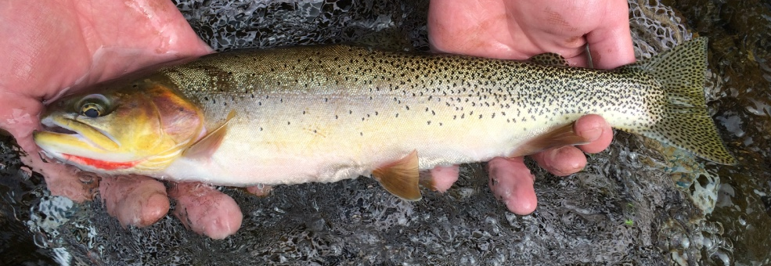
Headwater Stream Ecosystems
Zach Lessig

Slide 2

Why this study?
Stream metabolism incorporates information about all aerobic organisms and habitats.
Trout are the top predators in headwater streams and may indicate the functioning of lower trophic levels.
If stream metabolism relates to trout this could be used as a non invasive method for estimating fish population.

Slide 3
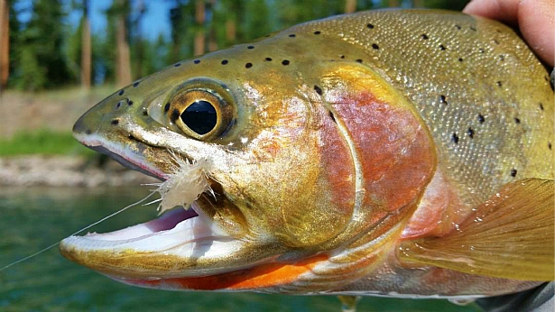
Why this study?
Objective:
Identify what headwater stream environmental variables best predict:
Ecosystem Respiration (ER)
Gross Primary Production (GPP)
Trout biomass.

Slide 4
Some terms…
Gross Primary Production (GPP) – this is the phototrophic synthesis of organic compounds using light and CO₂ which produces O₂.
Ecosystem Respiration (ER) – this is the release of CO₂ through metabolism by autotrophic and heterotrophic organisms which consumes O₂.
Trout Biomass – this is the estimated mass of all trout per stream reach.

Slide 5
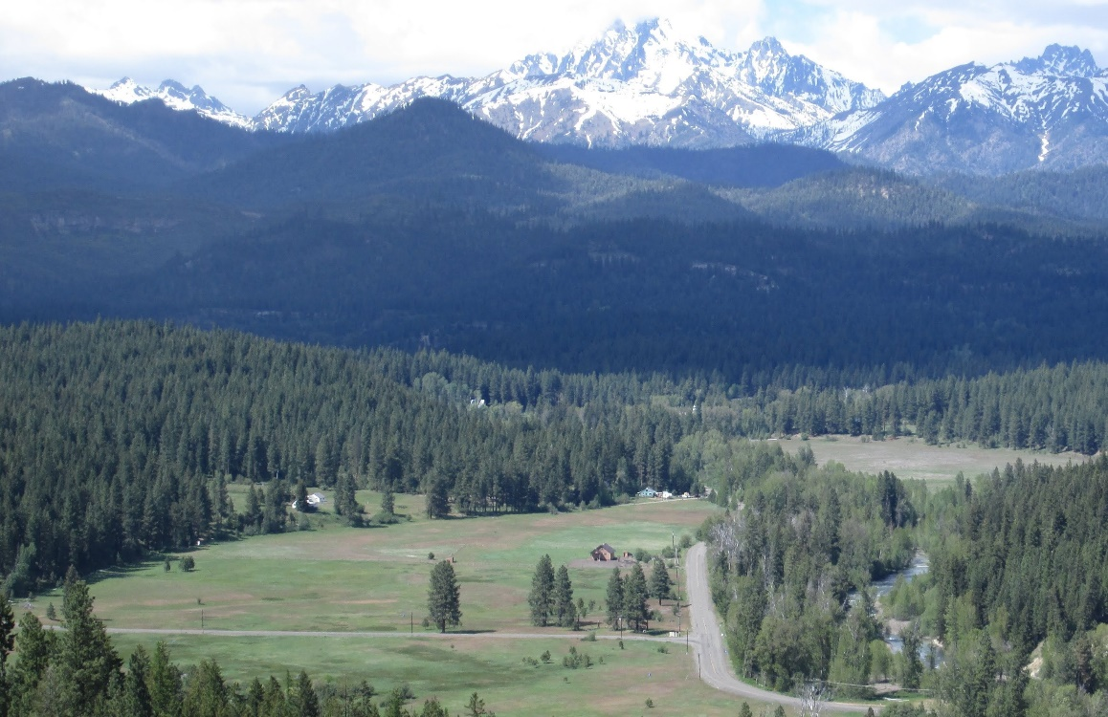
Basin
Swauk
Swauk
Iron
Blue
Hurley
Hovey
Teanaway
Miller
Jack
Standup
Taneum
First
Frost
Time of Sampling
Summer 2017
Fall 2017
Summer 2018

Slide 6
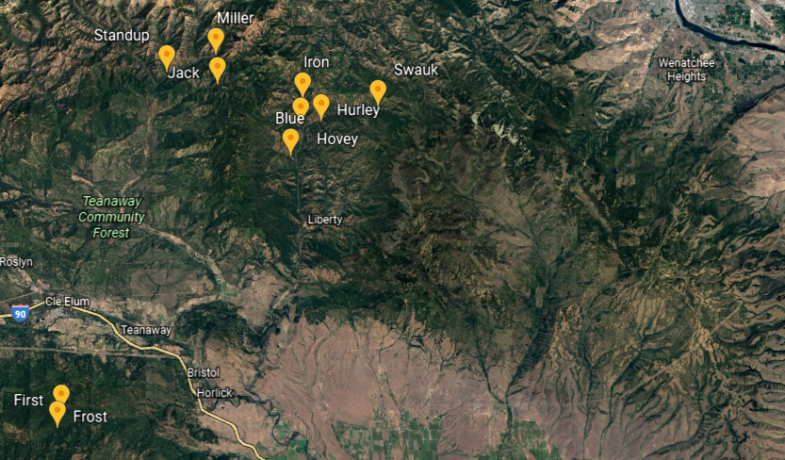
Teanaway watershed
Swauk watershed
Taneum watershed

Slide 7
Data Collected
Elevation (m)
Aspect (º)
Slope (%)
Bank Full (m)
Pebble Median (mm)
Wetted Width (m)
Depth (m)
Discharge (L/s)
Canopy (% open)
Carbon (C) (DOC mg C/L)
Nitrogen (N) (DIN mg N/L)
Phosphorus (P) (SRP mg P/L)
Photosynthetically Active Radiation (PAR) (µmol photons/m²/s)
Water Temperature (ºC)
Dissolved Oxygen (DO) (mg/L)
Cutthroat Biomass (g/m of stream)
Gross Primary Production (GPP) (g O₂/m²/d)
Ecosystem Respiration (ER) (g O₂/m²/d)

Slide 8
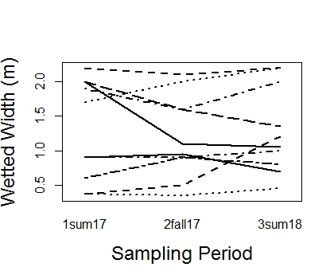
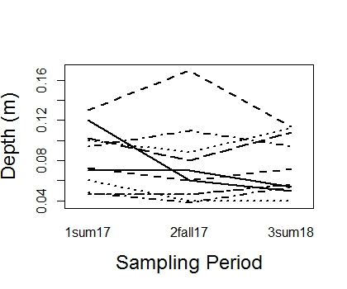
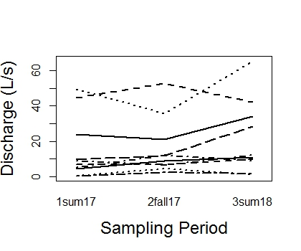
Hydrology Over Time
A
A
A
A
A
A
A
A
A
Width depth and discharge did not change over time.

Slide 9
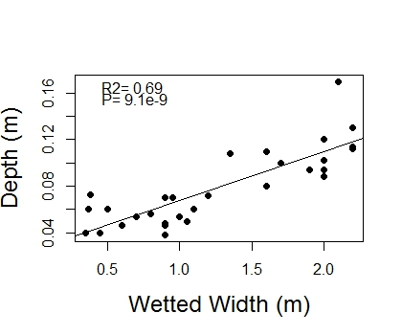
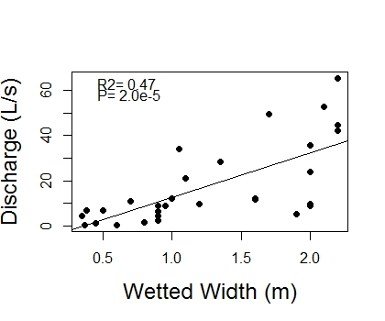
Hydrologic Relationships
Width, depth and discharge all increase together.

Slide 10
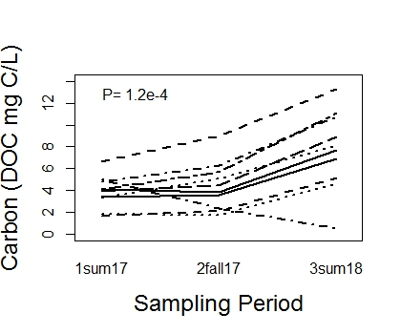
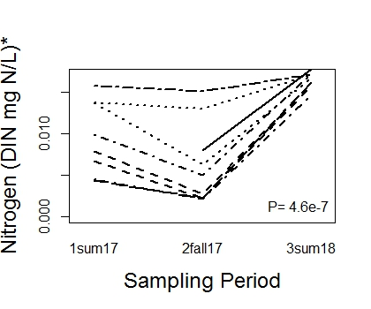
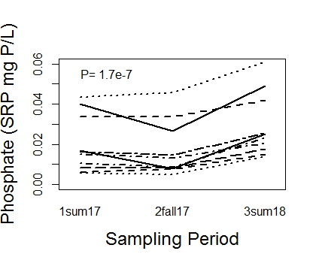
Nutrients Over Time
B
B
A
B
B
A
B
B
A
Nutrients do not differ at first 2 sampling periods and then go up for the third.

Slide 11
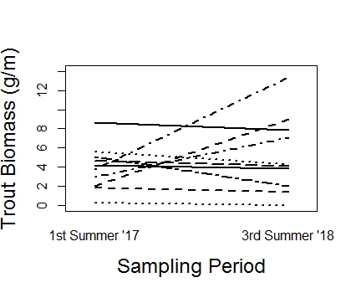
Trout Biomass
A
A
Trout biomass per stream length did not differ at the 2 different sampling periods.

Slide 12
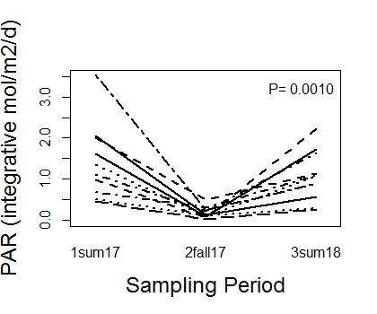
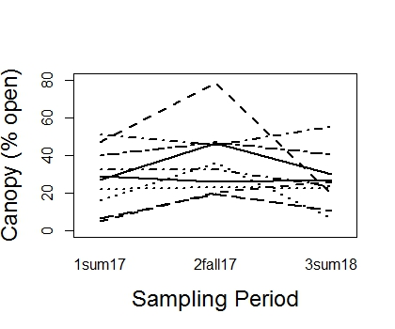
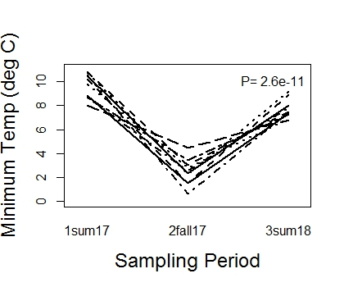
Light and Temp Over Time
A
B
A
A
A
A
A
C
B
Light and temperature follow expected seasonal patterns.
The temperature reflects an earlier sampling in the last summer than the first

Slide 13
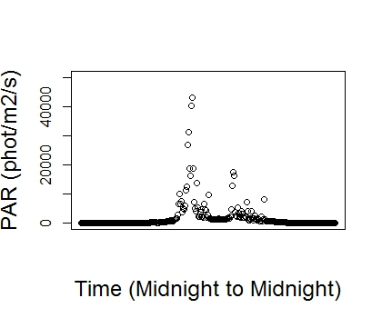
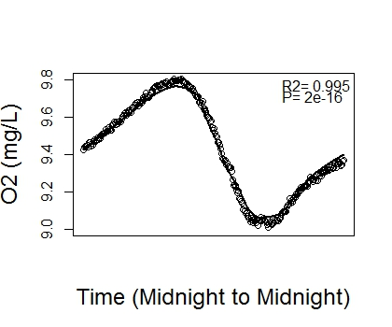
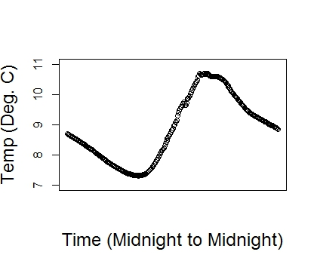
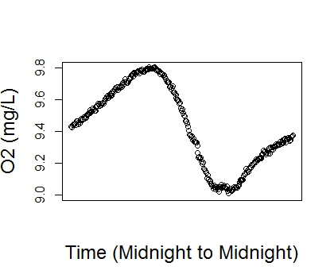
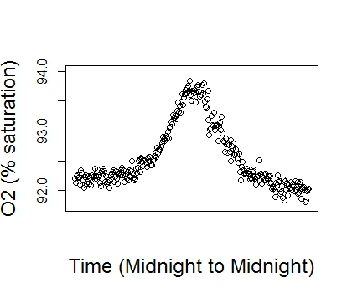
One station metabolism method using inverse modeling
Use this data to estimate:
Gas Exchange Constant (K600)
GPP
ER

Slide 14
Choosing a model to estimate metabolism
Use 1 model
Use 2 models
Run a model that estimates K600, GPP and ER
This method may risk an over-paramaterized model
This method produced less believable values
Derive K600 and use that for estimating GPP and ER
Run a “Nighttime Regression Model” that estimates K600
Derive K600 equation using “good” model output from the 1 model method
Derive K600 equation from literature data

Slide 15
Choosing a model to estimate metabolism
My Model for K600
Literature derived K600
Run models that estimate K600
Use “good” models to derive K600 where:
0<GPP
0>ER
0<K600
95<R2
Ln(K600)=1.6703*ln(Velocity)+3.2482
R2=0.27, P=0.07, N=26
Derive equation for K600 based on Hall (2018) to use in models
Ln(K600)=0.9557*ln(Slope)+3.0667
R2=0.68, P=0.01, N=8

Slide 16
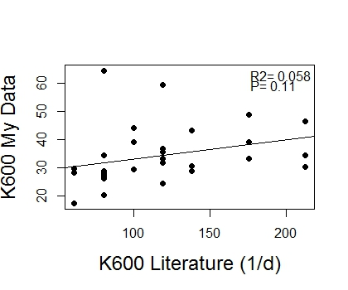
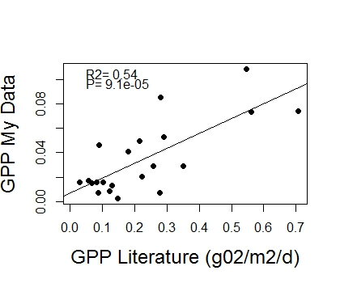
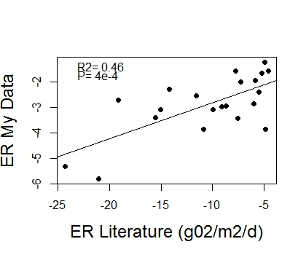
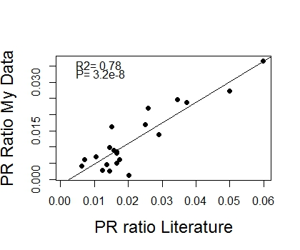
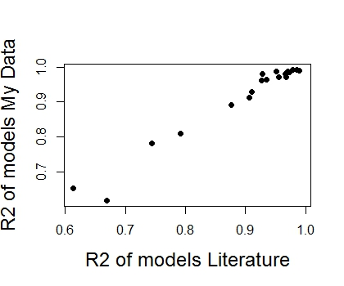
I chose the Literature derived equation.
4 of 30 models were dropped from further analysis.

Slide 17
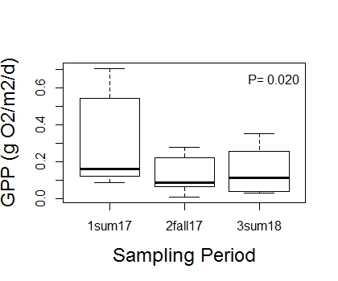
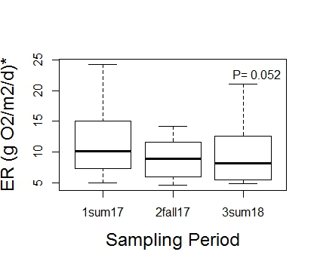
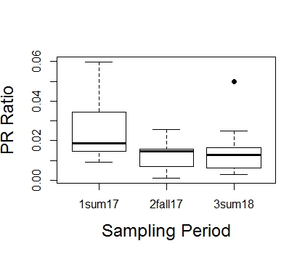
Metabolism Over Time
A
B
B
A
B
AB
A
A
A
Metabolism started off higher and then went down in magnitude for the following samplings.

Slide 18
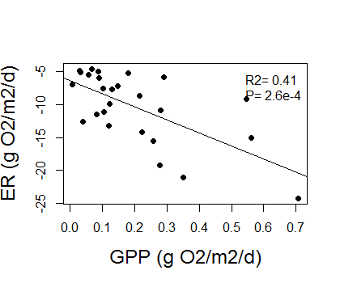
GPP and ER relationship
GPP and ER increase in magnitude together as expected.

Slide 19
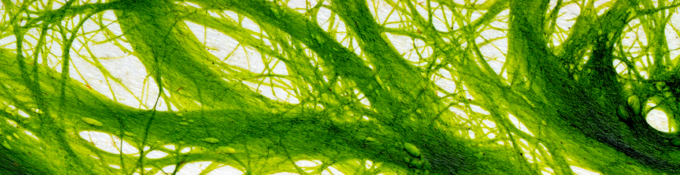
GPP model
LME (Transformed GPP ~ Sampling Period + Depth)
log(1+GPP)^(1/2)
Random effect by stream (random=~1|stream)
Constant variance by stream (varIdent(form=~1|stream))

Slide 20
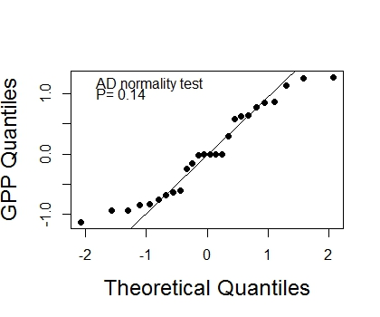
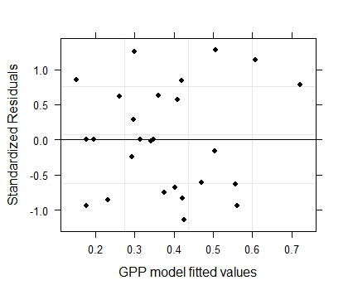
GPP Model Validation

Slide 21
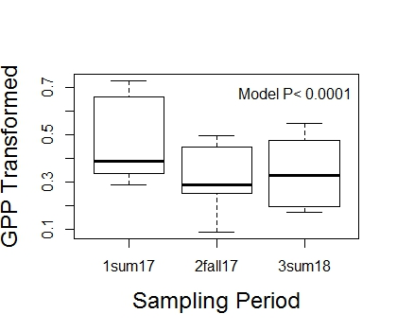
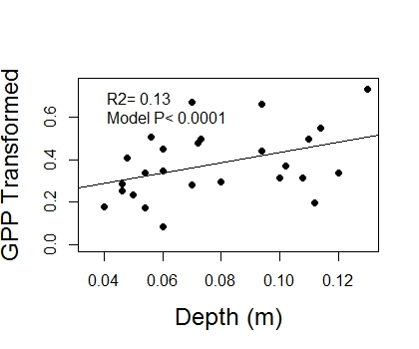
GPP Model Interpretation
GPP varies with sampling time and increases with depth.

Slide 22
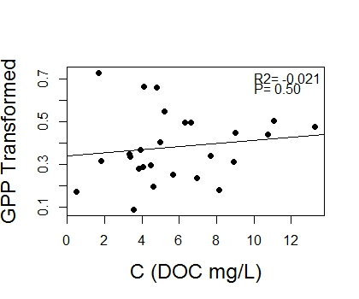
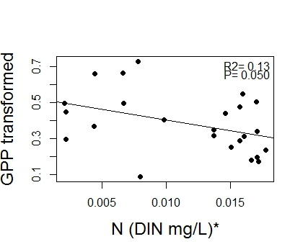
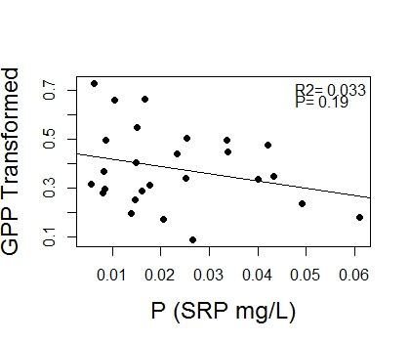
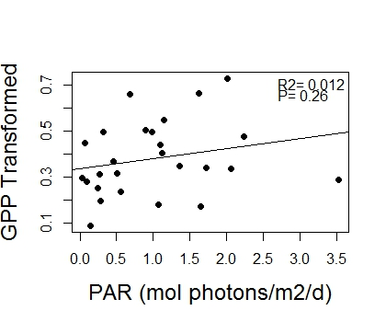
GPP Non-Model considerations
GPP appears unrelated to light and nutrients although weakly and negatively with DIN.

Slide 23

ER Model
LME (Transformed ER ~ Depth + Slope)
log(1+|ER|)
Random by stream (random=~1|stream)
Alternate data structure (method=ML)

Slide 24
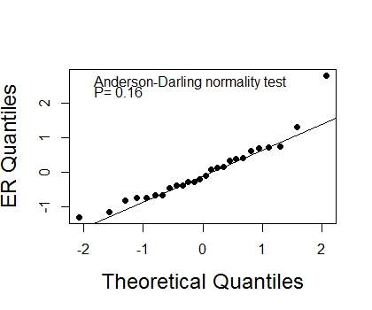
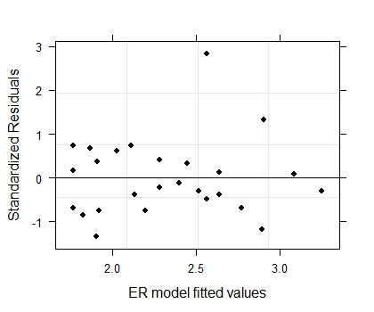
ER Model Validation
Hovey Summer ‘17

Slide 25
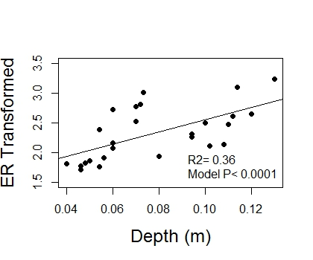
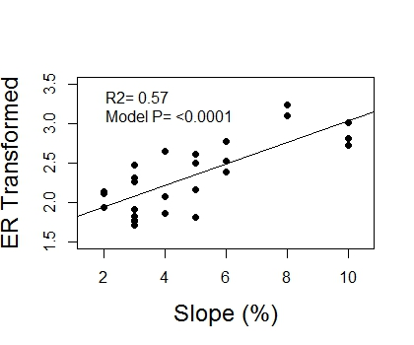
ER Model Interpretation
ER increases in magnitude with increasing depth and slope.

Slide 26
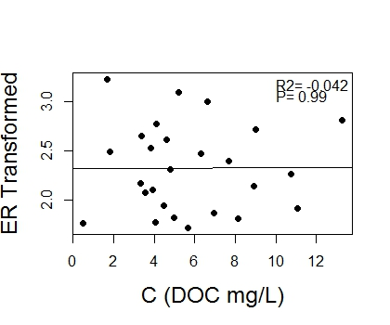
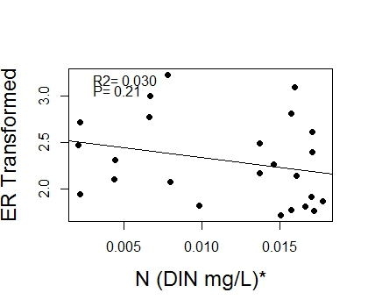
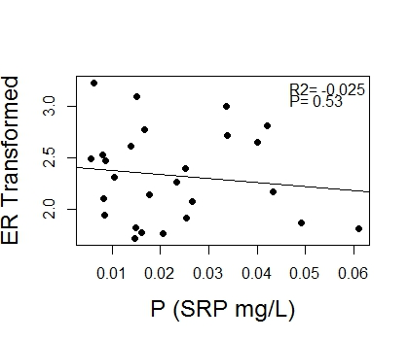
ER Non-Model Considerations
ER does not relate to nutrients.

Slide 27
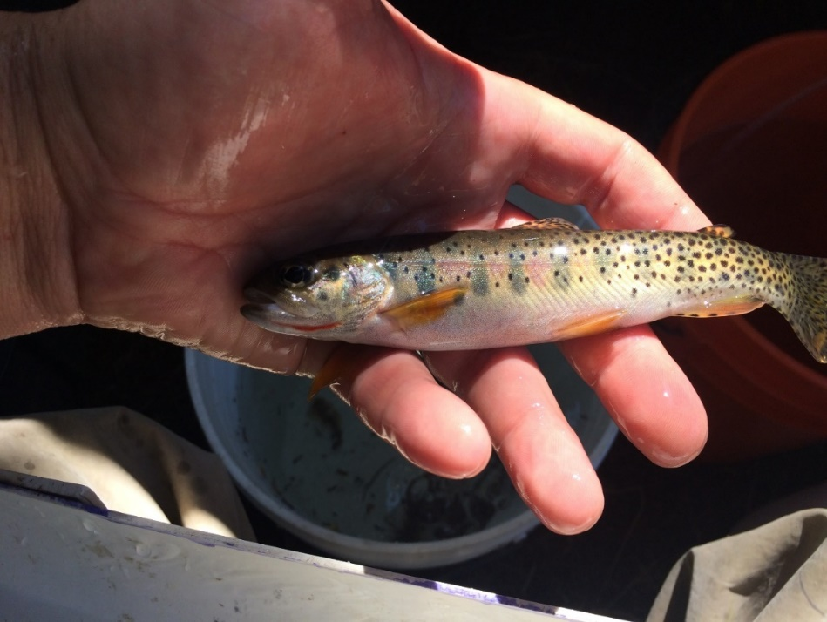
Trout Biomass Model
GLS(Transformed Trout Biomass ~ Basin + Width + Min Temp*Canopy Openness)
log(1+Trout Biomass)
Exponential variance structure (varExp(form = ~fitted(.))

Slide 28
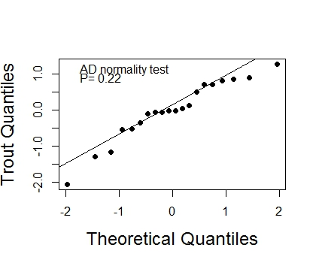
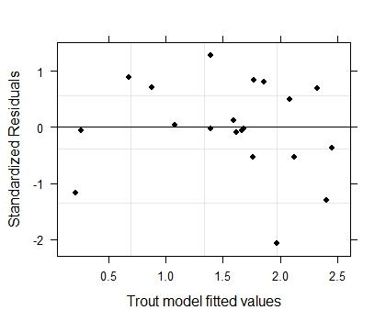
Trout Model Validation
Hurley Summer '18

Slide 29
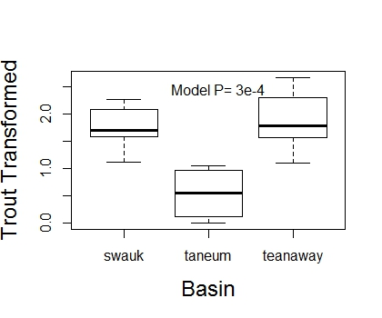

Trout Biomass Model Interpretation
Trout biomass per stream length varies on basin and increases with increasing width.

Slide 30



Trout Biomass Model Interpretation
More open
Less open
Low
Med
High
Trout biomass increases with decreasing temperature and increasing canopy openness.

Slide 31




Trout Non-Model Considerations
Trout biomass appears unrelated to light and nutrients although possibly weakly and negatively with SRP.

Slide 32


Other Considerations…
Trout biomass does not relate to ER or GPP.

Slide 33


Other Considerations…
SRP and DOC increase in magnitude together?

Slide 34
Metabolism varies with depth, slope and sampling period.
Depth and slope were used to estimate metabolism
Metabolism is not driven by light or nutrients
All sites are probably strongly light limited
Trout biomass and stream metabolism do not appear to relate to one another.
Trout biomass appears to be driven by temperature and canopy openness.

Slide 35

Questions?

Slide 36


Slide 37


Slide 38
season
season.yr
basin
stream
yr
elev
from.north
slope
bf
pebble
width
depth
velocity.mean
discharge
carbon
ammonia
nitrate
din
phosphate
cn.ratio
canopy
par.integrative
par.mean
par.max
temp.max
temp.min
temp.mean
cut.capt
cut.pop
cut.mass
cut.mass.m
sculp.mass.m

Slide 39



Geographic Site Variables

Slide 40


Hydrologic Site Variables

